Slide 1
IPv6 – A 10,000m Perspective
Geoff Huston
Chief Scientist, APNIC

Slide 2
Why?

Slide 3
Because we’ve run out of addresses!

Slide 4
again!

Slide 5
A bit of history...
The original ARPAnet design of 1969 used the NCP protocol, which used 8 bit addresses
  Maximum network size of 256 nodes
  Enough, yes?

Slide 6
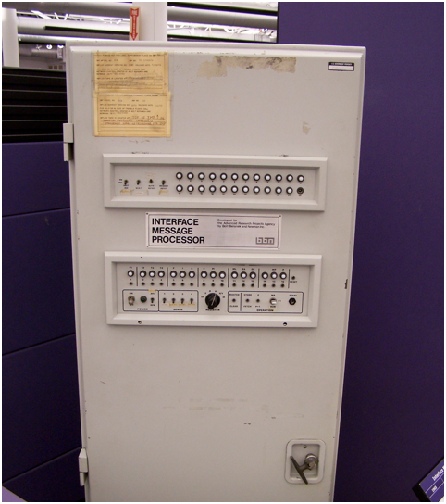
ARPAnet IMP - 1970’s

Slide 7
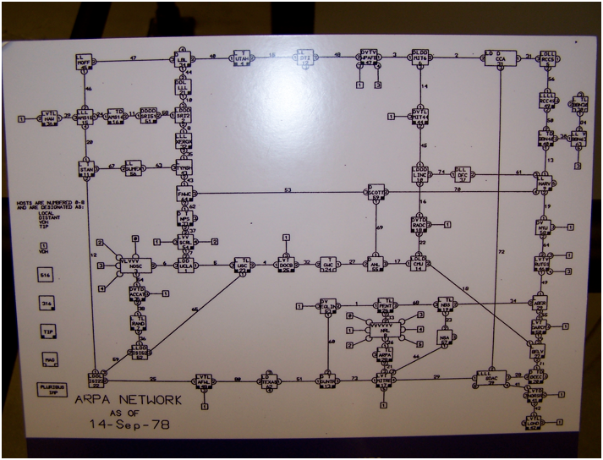
ARPAnet - September 1978

Slide 8
Transition V1.0
Turns out that 8 bits of addresses was not enough for the next generation of mini computers
ARPAnet undertook a transition from NCP to a new protocol: TCP/IP
  Expansion from 8 to 32 bit addresses
  Flag Day: 1 January 1983
  Shutdown and reboot every node into the new protocol

Slide 9
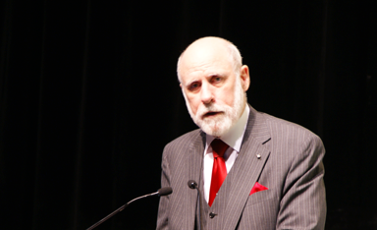
“This time, for sure!” *
Vint Cerf, APRICOT, Feb 2011
* Actually Vint didn’t say this!

Slide 10
IP Version 4
32 bit address field
  That’s 4,294,967,296 addresses
A triumph of minimalism
  Basic datagram architecture
  Stateless network with admission control and without active resource management
  Variable packet size with fragmentation on the fly
  Basic header set: Source, Destination, Fragmentation Control, checksums, all in 20 octets
  Decoupled framework of related functions

Slide 11
It Worked!
The minimal approach allowed for more efficient use of the common network
  It was cheap
  It was easy
  It scaled

Slide 12
It Worked too well!
Back in 1983 noone ever truly believed that IP would be the single communications protocol for the 21st century
  And you would be mad for thinking that
  OSI was meant to be the answer
  And we understood so little about computing and communications that it was equally possible that we would find something better than packet switching pretty soon
  So 32 bits of address space was looking like a decent engineering tradeoff

Slide 13
The cloud on the horizon...
Frank Solensky, IETF, August 1990

Slide 14
Doomsday – Mk 1
Frank Solensky, IETF, August 1990

Slide 15
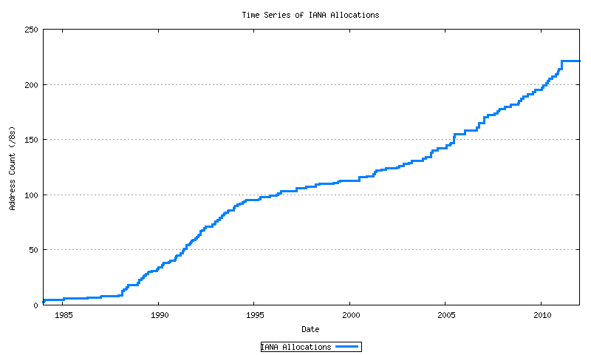
IPv4 Address Allocations
Class B Nets
A&R networks
NSFNET

Slide 16
The CIDR Band-Aid
It was clear by 1991 that we needed a new protocol
  There was just no way we could hack extra bits of address space into the IPv4 header
  And maybe we should think about what should/and should not be in the packet header at the same time as we enlarged the address size
So we needed to buy a few years of breathing space
  We did this by removing the fixed network/host boundary points
  Classless Inter-Domain Routing was rushed in as a quick fix

Slide 17
The CIDR Fix
Class-full
CIDR
A&R networks
NSFNET

Slide 18
And the long term plan?
IPng
  There was no OSI any more, so this had to be the one and only protocol in the eyes of the protocol designers
  It was envisaged to have a lifespan of 30 – 100 years
  And encompass ubiquitous deployment to the order of trillions of connected nodes

Slide 19
Problem Solved!
We set the protocol designers onto the problem
  we were naive enough to think that a committee could engineer a better architecture
We planned to worry about transition on a later day once the protocol design had been worked out
And we turned back to building the network
  and making money
  a LOT of money, as it turned out

Slide 20
zzzzzz
For a while the problem of the need for a new protocol became LESS urgent
  The network grew at ever faster rates
  But CIDR allowed us to use vastly fewer addresses
  And then consumer NATS allowed us to use even fewer addresses
  So IPv6 became a perennial “sometime” issue that never quite became a “now” item

Slide 21
IPv4 + CIDR + NATs worked!
Class-full
CIDR
A&R networks
NSFNET

Slide 22
And worked...
Broadband
Boom & Bust
CIDR
A&R networks
NSFNET

Slide 23
And worked!
Mobiles
Broadband
Boom & Bust
CIDR
A&R networks
NSFNET

Slide 24
Until it didn’t work any more!
Exhaustion!
Mobiles
Broadband
Boom & Bust
CIDR
A&R networks
NSFNET

Slide 25
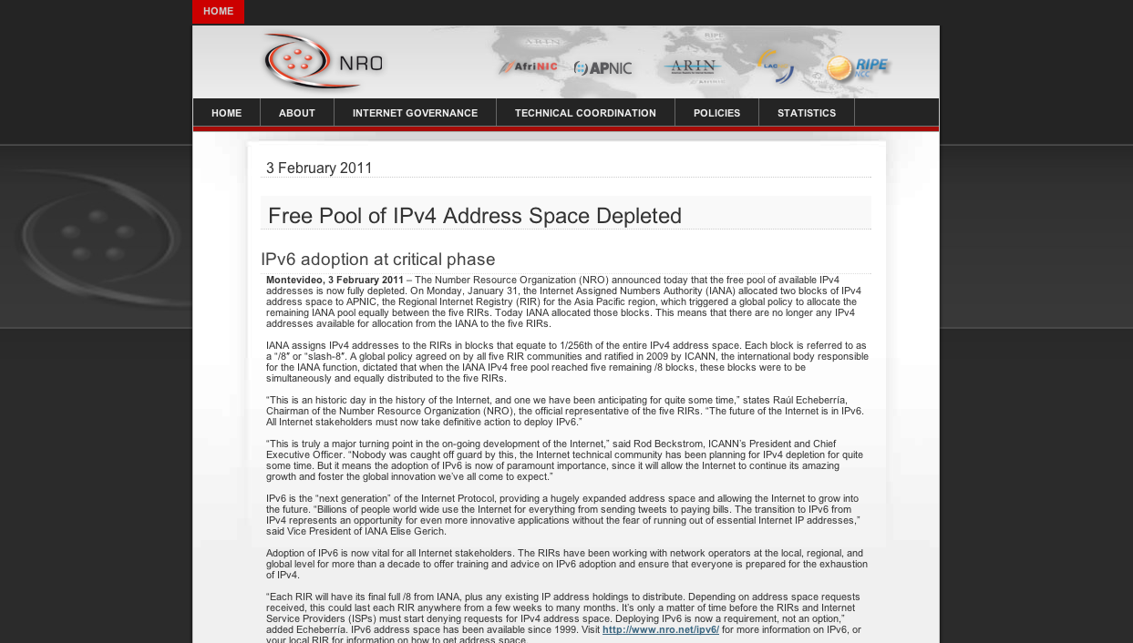
Ooops!

Slide 26

IPocalypse?

Slide 27
Maybe not
Its a massive industry
And exhaustion is not a sudden state change
But the network grew by more than 280 million services in 2011
  Which was the largest year so far for the Internet

Slide 28
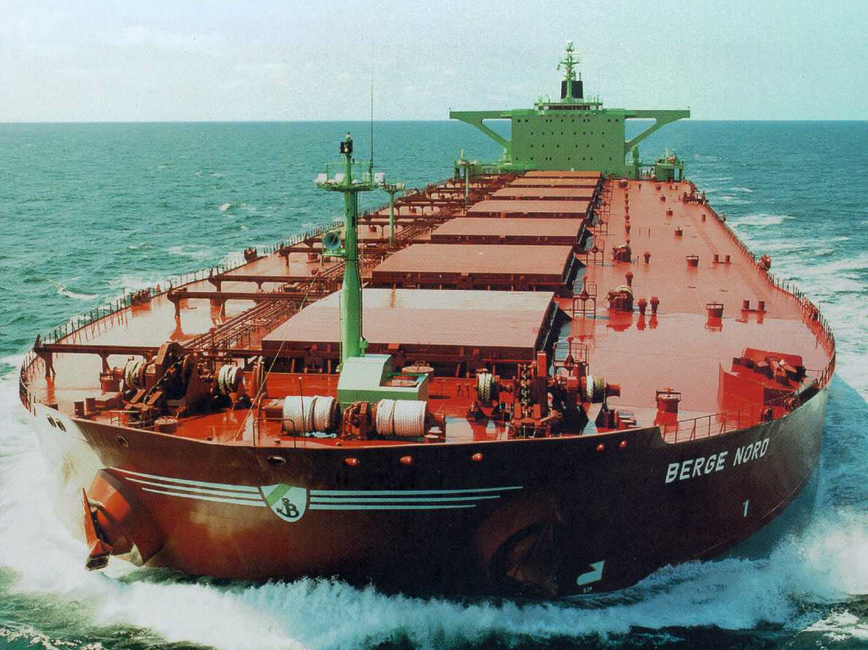
It’s more like this!

Slide 29
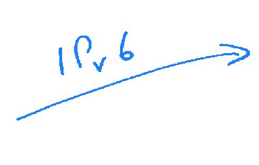



Transition is hard!

Slide 30
Switchover?
We all agree to turn off IPv4 and turn on IPv6 EVERYWHERE
All at the same time! All over the Internet!

Slide 31
Switchover?
We’re just too big!
We all agree to turn off IPv4 and turn on IPv6 EVERYWHERE
All at the same time! All over the Internet!

Slide 32
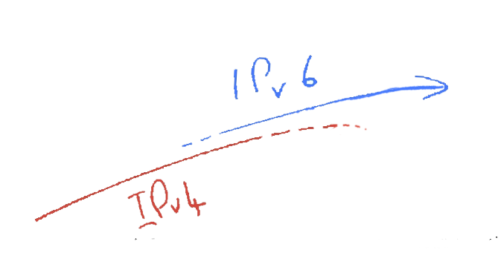
Piecemeal Switchover?
One-by one networks switchover to Ipv6,
Switching off ipv4 when they complete their transition

Slide 33
Piecemeal Switchover?
IPv6 is NOT backwards
compatible!
One-by one networks switchover to IPv6,
Switching off ipv4 when they complete their transition

Slide 34
Dual Stack Transition
IPv4
IPv6
One-by one networks and hosts have IPv6 added to IPv4
Switching off ipv4 when every element has both IPv4 and IPv6

Slide 35
Dual Stack Transition
Size of the Internet
IPv6 Deployment
IPv6 Transition – Dual Stack
IPv4 Pool Size
Time
For this to work we have to start early and finish BEFORE IPv4 address pool exhaustion

Slide 36
Dual Stack Transition
We’re just too late!
IPv4
IPv6
One-by one networks and hosts have IPv6 added to IPv4
Switching off ipv4 when every element has both IPv4 and IPv6

Slide 37
Dual Stack Transition
Size of the Internet
IPv6 Deployment?
IPv6 Transition – Dual Stack
IPv4 Pool Size
???
2006
2008
2010
2012
2014
Date

Slide 38
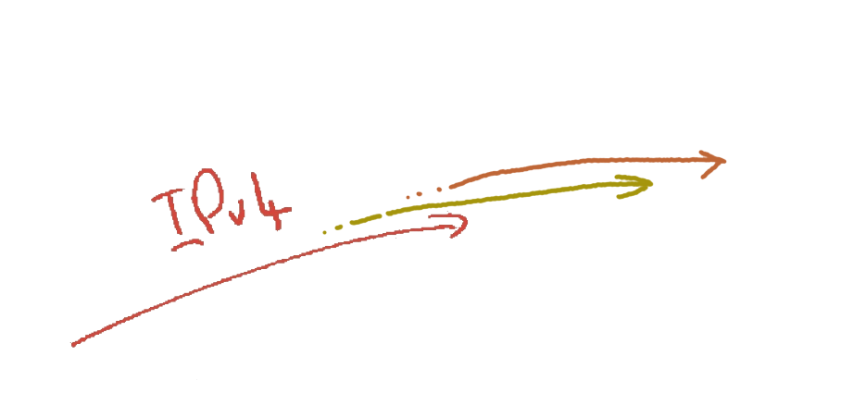
More Band Aids!
+ALGs
+CGNs
IPv4
The increasing scarcity of Ipv4 will force carriage providers to add address sharing mechanisms into the IPv4 network

Slide 39

Plan F – The Kitchen Sink Approach!
This is going to be very
tricky!
IPv6
To get from “here” to “there” requires an excursion through an environment of CGNs, CDNs, ALGs and similar middleware ‘solutions’ to IPv4 address exhaustion
CGNs
IPv4
ALGs
CDNs

Slide 40
Where are we with IPv6?
It’s a mixed story
  Some components of the Internet have had IPv6 for many years
    There is far more IPv6 out there in the Internet if you know where to look
    About one half of today’s Internet devices show that they have an active IPv6 stack
  But some critical parts of the Internet are still determined not to make any shift away from IPv4
    While one half of the Internet’s devices have IPv6, less that 1 in a hundred devices can actually use IPv6 on the Internet

Slide 41
Where are we with IPv6?
Every Host?
  50% do, 50% do not
  Strong Points:
    Microsoft Windows Vista and 7 with IPv6 on by default
    Mac OSX with IPv6 on by default
    Unix servers with IPv6 on by hand
  Weak points:
    Mobile devices do NOT have IPv6 in their radio systems
      Any many do not have it at all so far
    Waiting for the world to turn off XP

Slide 42
Where are we with IPv6?
Every Network?
  50% of the transit networks do, 50% do not
  4% of the access networks (or less) do
    Weak points:
      DSL deployments with customer-owned CPE are a major impediment to transition
      BRAS / BFLETs IPv4 only
      CPE IPv6 story is patchy to bad
      3G networks are a problematical in GGSN services
      4G networks – still early days
  Server / Data centre infrastructure weak
    Not many of the load management products support IPv6
    And dual stack in a data centre is messy
    IPv6 internals with a dual stack external presentation is an efficient approach for a data centre – but few centres are willing to make the call and transition to Ipv6 yet

Slide 43
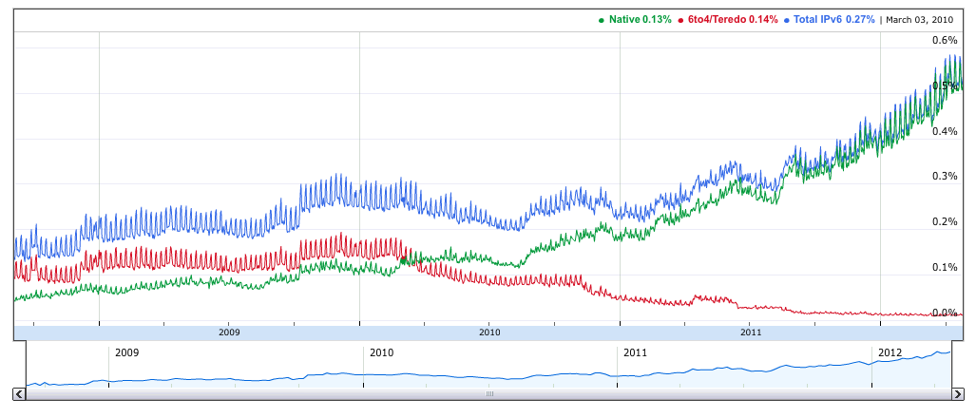
Where are we with IPv6?
In April 2012 only 0.5% of users access Google’s dual stack
services using IPv6
http://www.google.com/intl/en/ipv6/statistics/

Slide 44
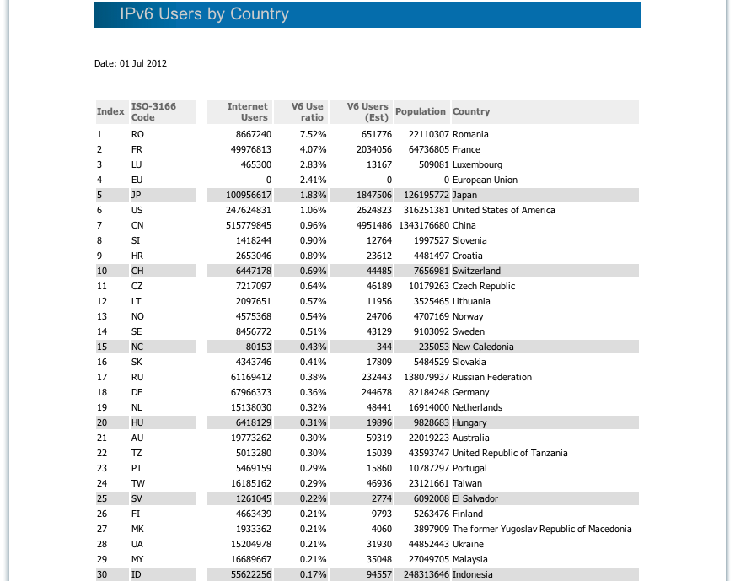
Where is Australia with IPv6?

Slide 45
These are low numbers
Less than 1% of the Internet’s user base with IPv6 active in 2012 is a very weak position
And time is running out
This cannot be an extended transition
  Either we all move and move the entire Internet to supporting IPv6 by around 2015
  Or we’ll lose focus and momentum and turn our collective attention to engineering insane adornments for CDNs, ALGs and similar active middleware in an all-IPv4 network

Slide 46
This was always going to be tough
Deregulated industry structure
Commoditization of carriage provision
Dominance of content services
Disjoint cost and benefit in V6 deployment for access provider industry
Significant resistance from the carrier sector
No clear consumer benefits in cost or utility

Slide 47
Why should you care?
No perceived need - already have IPv4 for enterprise
Few IPv6 enterprise products available
No IPv6 expertise in IT management and operations units
Difficult, costly, and it addresses no perceived need

Slide 48
BUT
Why did you deploy IPv4 in the first place?
Everyone else was using it
It was cheap
Our customers and providers
were using it

Slide 49
BUT
Why did you deploy IPv4 in the first place?
Everyone else was using it
It was cheap
Our customers and providers
were using it

Slide 50
If not IPv6 ...
There is no other plan!
The path with IPv4 leads to Carrier NATS, Application Level Gateways and ultimately to fragmentation and piecemeal networks
The major benefits of IPv4 lie in its openness and universality
  neither of these are sustainable attributes for more than 2 – 3 years at most!
  After that expect to see IPv4 segment itself into a set of carrier-limited islands

Slide 51
Timing is everything
What’s your threshold for IPv6?
There are no clear first adopter advantages
So “wait and see” is a pervasive attitude
But there are clear long term common risks of inaction in terms of cost, efficiency, openness and utility of the common network platform
“when” is a big question here if we all want to avoid these risks

Slide 52
A Modest Suggestion
Start small, but start now
  Dual Stack the external front of house
    Contract with your data centre / service provider for front-side IPv6 access
    Put IPv6 on your front of house service platforms
    Enable Dual stack your server application
    Add AAAA records to your DNS
    Include IPv6 monitoring in your operational monitoring
    Measure the results

Slide 53
And while you are at it...
No more purchasing “IPv4 only” products
Dual stack should be a mandatory purchase criteria
  Its a simple case of ensuring a reasonable service life for your equipment
  And it also exposes your operational environment to introducing dual stack services internally
  And allows you to flexible in adjusting to the moves of your suppliers, peers and customers

Slide 54
What changes with IPv6?

Slide 55
What changes with IPv6?
Not much
  Most users never notice when they connect to a dual stack access network
  It’s still the Web, its still the Internet, and things work much the same as ever
But that’s what we intended – if nothing changes then we’ve succeeded!

Slide 56
However, it’s not perfect
We learned a huge amount as we deployed IPv4
And its clear that IPv6 still has its wrinkles
And doubtless many network operators and their customers will encounter new issues in this deployment
But that’s no excuse to wait...

Slide 57
We need to move quickly with IPv6

Slide 58

as there is just no more IPv4!

Slide 59
Thank You

