Slide 1
Fragmentation
Geoff Huston
APNIC Labs

Slide 2
Before Packets…
Digitised telephone networks switched time
  Each active network transaction was a 56K constant bit rate data stream
  Each stream was divided into 8,000 7 bit samples per second
  Each 7 bit sample was aggregated with other samples and packed into frames
  Each frame was switched at 8K frames per second

Slide 3
Packets are Different
Computers do not require constant bit rate
They can optimise their data rates to make efficient use of the network
They can vary the packet size to match the requirements of the application and the network
They do not rely on a network state – each packet contains information in the header to allow it to be passed to the destination

Slide 4
Packet Networks are Different
The range of packet sizes supported in a network represents a set of engineering trade-offs
  Bit error rate of the underlying media
  Desired carriage efficiency
  Transmission speed vs packet switching speed

Slide 5
Media Packet Sizes
Ethernet 64 – 1,500 octets
  These numbers were derived from the original CSMA-CD design
FDDI 4,532 octets
Frame Relay 46 – 4,470 octets
ATM 53 octets
BER, Framing, FEC (or not), Jitter, HOL blocking, etc all play a role in the design tradeoffs for media packet sizes

Slide 6
The IEEE Jumbogram Fiasco
1500 octets was fine for 10Mbps
  800 packets per second
But at 100Gbps?
  8,000,000 pps
So why not allow for larger packets?
Yes, but what size?
  IEEE found themselves incapable of standardizing which size to pick
  So they ended up picking none!

Slide 7
Protocol Design
Adopt a fixed packet size approach
  Tends to be a lower number (see ATM)
  Decreases carriage efficiency and increases packet switching loads
Adopt a variable size approach
  Maximises applicability
  Maximises carriage efficiency
  But the protocol needs to cope with packet size mismatch as a packet traverses multiple networks

Slide 8
IPv4 Packet Design
FORWARD fragmentation
  If a router cannot forward a packet on its next hop due to a packet size mismatch then it is permitted to fragment the packet, preserving the original IP header in each of the fragments

Slide 9
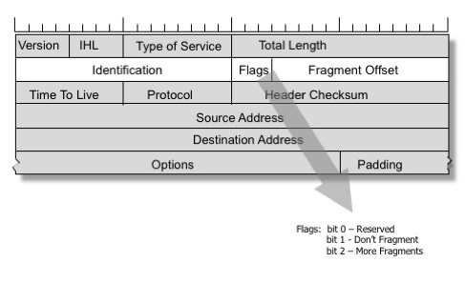
IPv4 Fragmentation Control

Slide 10
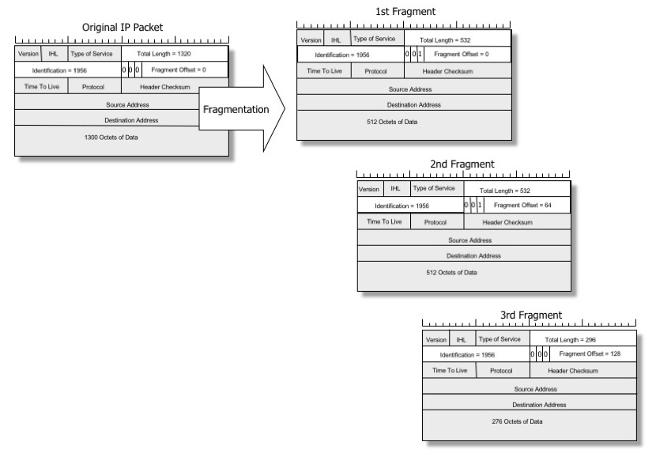
IPv4 Fragmentation

Slide 11
IPv4 and the Don’t Fragment bit
If Fragmentation is not permitted by the source, then the router discards the packet. The router may send an ICMP to the packet source with an Unreacahble code (Type 3, Code 4)
Later implementations added a MTU size to this ICMP message
ICMP messages are extensively filtered in the Internet so applications should not count on receiving these messages

Slide 12
Trouble at the Packet Mill
Lost frags require a resend of the entire packet – this is far less efficient than repairing a lost packet
Fragments represent a security vulnerability as they are easily spoofed
Fragments represent a problem to firewalls – without the transport headers it is unclear whether frags should be admitted or denied
Packet reassembly consumes resources at the destination

Slide 13
The thinking at the time…
Fragmentation was a Bad Idea!
Kent, C. and J. Mogul, "Fragmentation Considered Harmful", Proc. SIGCOMM '87 Workshop on Frontiers in Computer Communications Technology, August 1987

Slide 14
IPv6 Packet Design
Attempt to repair the problem by effectively jamming the DON’T FRAGMENT bit to ON
IPv6 uses BACKWARD signalling
  When a packet is too big for the next hop a router should send an ICMP6 TYPE 2 (Packet Too Big) message to the source address and include the MTU of the next hop.

Slide 15
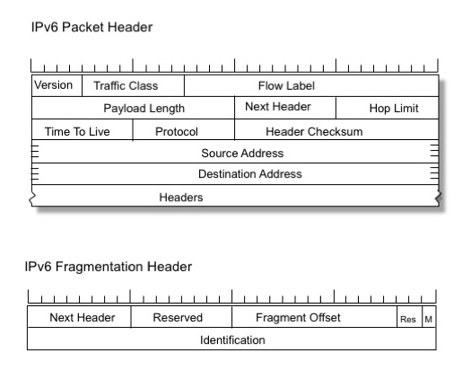
IPv6 Source Fragmentation

Slide 16
What changed? Whats the same?
Both protocols may fragment a packet at the source
Both protocols support a Packet Too Big signal from the interior of the network to the source
Only IPv4 routers may generate fragments on-the-fly

Slide 17
What does “Packet Too Big” mean anyway?
errrrr

Slide 18
It’s a Layering Problem
Fragmentation was seen as an IP level problem
  It was meant to be agnostic with respect to the upper level (transport) protocol
But we don’t treat it like that
  And we expect different transport protocols to react to fragmentation notification in different ways

Slide 19
What does “Packet Too Big” mean anyway?
For TCP it means that the active session referred to in the ICMP payload* should drop its session MSS to match the MTU **
i.e. you should never see IPv6 fragments in TCP!
    * IPv4: assuming that the payload contains the original IP header
    ** assuming that the ICMP is genuine

Slide 20
What does “Packet Too Big” mean anyway?
For UDP its not clear:
  The offending packet has gone away!
  Some IP implementations appear to ignore it
  Others add a host entry to the local IP Forwarding table that records the MTU

Slide 21
Problems
ICMP is readily spoofed
  An attacker may send a fragment stream with a maximum fragment offset value causing a potential memory starvation issue on the destination
  A attacker may send partially overlapping fragments
  An attacker may spoof ICMP PTB messages with very low MTU values
  An attacker may spoof a stream of ICMP PTB messages with random IPv6 source addresses

Slide 22
Problems
Therefore ICMP is widely filtered
  leading to black holes in TCP sessions
    GET is a small HTTP packet
    The response can be arbitrarily large, and if there is a path MTU mismatch the response can wedge
Get
Response

Slide 23
Problems
Therefore ICMP is widely filtered
  Ambiguity in UDP
    Is packet loss due to congestion or MTU mismatch?
    Should I give up, resend or revert to TCP?

Slide 24
Problems
Backward signalling is unreliable
  In no other part of the IP protocol is it assumed that the source address of an IP packet is reliably reachable by anything other than the addressed destination
  Source addresses are not necessarily “real”
    MPLS
    IP tunnels
    SDN

Slide 25
Who should control packet fragmentation?
Is fragmentation and reassembly an IP-Layer function or a Application Session function?
  i.e. is the DNS use of EDNS0 buffer size options with explicit max MTU signalling under application control a better approach than allowing the IP layer to manage this?

Slide 26
e.g. DNS and EDNS0
The DNS is the most critical user of UDP
Developments in security protocol evolution has lead to larger DNS responses
DNS took on explicit fragmentation control with EDNS0
  Loss of fragment coherence leads to re-query with lower buffer size, which leads to fallback to TCP
  This is controlled by the DNS application, not the network layer

Slide 27
Where now?
Option 1
Deprecate Fragmentation?
  Bonica had a draft on this for IPv6:
  draft-bonica-6man-frag-deprecate-02

Slide 28
Where now?
Option 2
Walk away from variable size and adopt a single max MTU for IP?
  But what is the “single” MTU size?
    65535?
    9000?
    1500?
    1280?
    512?
    ???

Slide 29
Where now?
Option 3
Keep fragmentation, and try and make ICMP PTB work consistently and reliably across all of the Internet for IPv6 (and IPv4)?

Slide 30
or
Option 0
Just do nothing and just hope it all goes away!

Slide 31
Discuss!

