Slide 1
The Foundations of Network Security
Geoff Huston AM
Chief Scientist, APNIC

Slide 2
The Foundations of Network Security
Insecurity!
Geoff Huston AM
Chief Scientist, APNIC

Slide 3
1. The Current Security Framework for the Internet

Slide 4
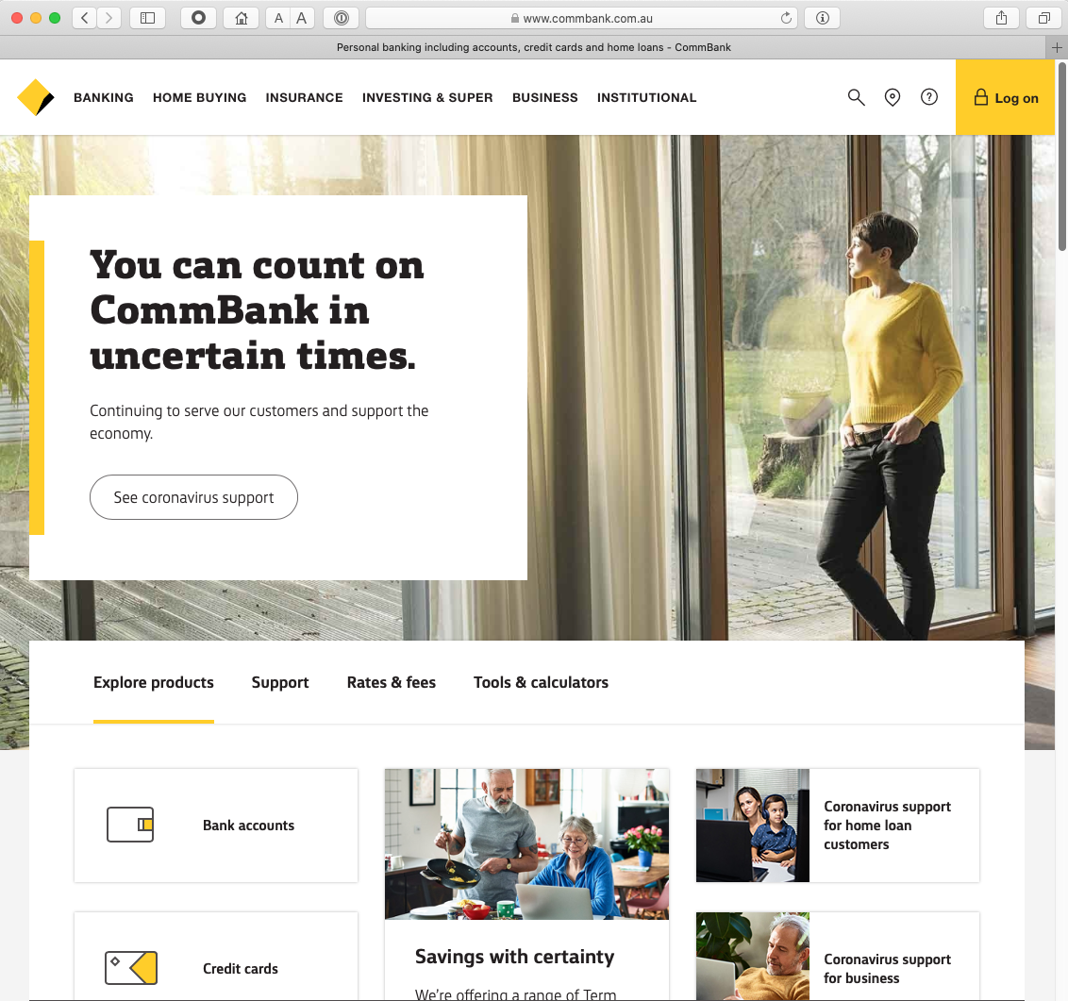
Which Bank?
Let’s start with a simple example:
Why should you pass your account and password to this web site? It might look like your bank, but frankly it could just as easily be a fraudulent site intended to steal your banking credentials. Why should you trust what you see on the screen?

Slide 5
Which Bank? My Bank!
I hope!
Ok – its not a random example. It’s the online bank I use! But the same question is still there. Why should I trust this web page?

Slide 6
Security on the Internet
How do you know that you are really going to where you thought you were going to?
Its trivial to create a web page to look exactly like another

Slide 7
Security on the Internet
How do you know that you are really going to where you thought you were going to?
So why should I enter my username and password into this particular screen?
And what does this padlock icon really mean?
Its trivial to create a web page to look exactly like another

Slide 8


Opening the Connection: First Steps
Client:
DNS Query:
www.commbank.com.au?
DNS Response:
104.116.164.218
TCP Session:
TCP Connect 104.116.164.218, port 443

Slide 9
Hang on…
Who “owns” that IP address? The Commonwealth Bank? Someone else?
Let’s look at little more:
$ dig -x 104.116.164.218 +short
a104-116-164-218.deploy.static.akamaitechnologies.com

Slide 10
Hang on…
$ dig -x 104.116.164.218 +short
a104-116-164-218.deploy.static.akamaitechnologies.com
That’s not an IP addresses that was allocated to the Commonwealth Bank!
  The Commonwealth Bank of Australia has the address blocks
  140.168.0.0 - 140.168.255.255 and
  203.17.185.0 - 203.17.185.255

Slide 11
Hang on…
$ dig -x 104.116.164.218 +short @::1
a104-116-164-218.deploy.static.akamaitechnologies.com
That’s an Akamai IP address
And I’m NOT a customer of the Internet Bank of Akamai!
Why should my browser trust that 104.116.164.218 is really the authentic web site for the Commonwealth Bank of Australia, and not some dastardly evil scam designed to steal my passwords and my money?
And why should I trust my browser?

Slide 12
The major question…
How does my browser tell the difference between an intended truth and a dastardly lie?

Slide 13
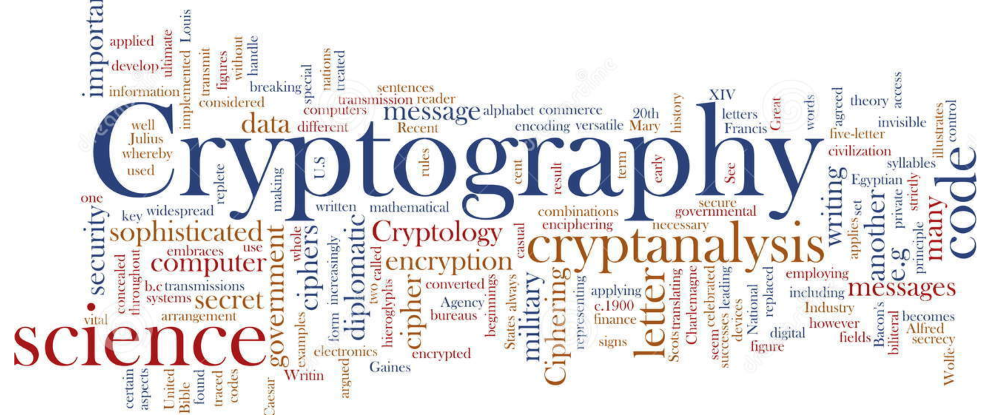
It’s all about cryptography

Slide 14
Public Key Cryptography
Pick a pair of keys such that:
  Messages encoded with one key can only be decoded with the other key
  Knowledge of the value of one key does not infer the value of the other key
  Make one key public, and keep the other a closely guarded private secret

Slide 15
This is important
So I will repeat it:
  Using public/private key cryptography requires a pair of keys (A,B) such that:
    Anything encrypted using key A can ONLY be decrypted using key B, and no other key
    Anything encrypted using key B can ONLY be decrypted using key A, and no other key
    Knowing the value of one key WILL NOT let you work out the value of the other key anytime soon!
This form of asymmetric cryptography lies at the heart of the Internet’s security framework

Slide 16
Public/Private Key Pairs
If I have a copy of your PUBLIC key, and you encrypt a message with your PRIVATE key, and I can decrypt the message using your PUBLIC key, then
  I know no one has tampered with your original message
  And I know it was you that sent it.
  And you can’t deny it.
If we negotiate a session key using the combination of your public key and a local private session key and encrypt all session messages using this session key, then
  I am confident no one else can eavesdrop on our conversation in this session

Slide 17
Public Key Certificates
But how do I know this is YOUR public key?
  And not the public key of some dastardly evil agent pretending to be you?
I don’t know you
I’ve never met you
So, I have absolutely no clue if this public key value is yours or not!

Slide 18
Public Key Certificates
What if I ‘trust’ an intermediary*?
  Who has contacted you and validated your identity and conducted a ‘proof of possession’ test that you have control of a private key that matches your public key
If this trusted intermediary signs an attestation that this is your public key (with their private key) then I would be able to trust this public key
This ‘attestation’ takes the form of a “public key certificate”
* If you have ever used “public notaries” to validate a document, then this is a digital equivalent

Slide 19
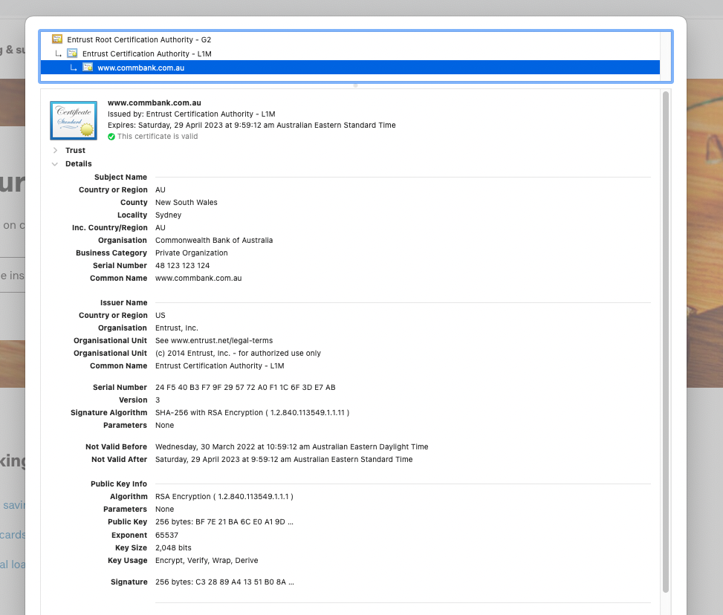
I trust that this is the web site of the Commonwealth Bank because I used the Commonwealth Bank’s public key to set up the encrypted connection to the server.
And I can trust that this is the Commonwealth Bank’s public key because I trust that Entrust has performed a number of checks before issuing a public key certificate for this public key

Slide 20
And another example
Let’s take www.apnic.net and look at that certificate

Slide 21
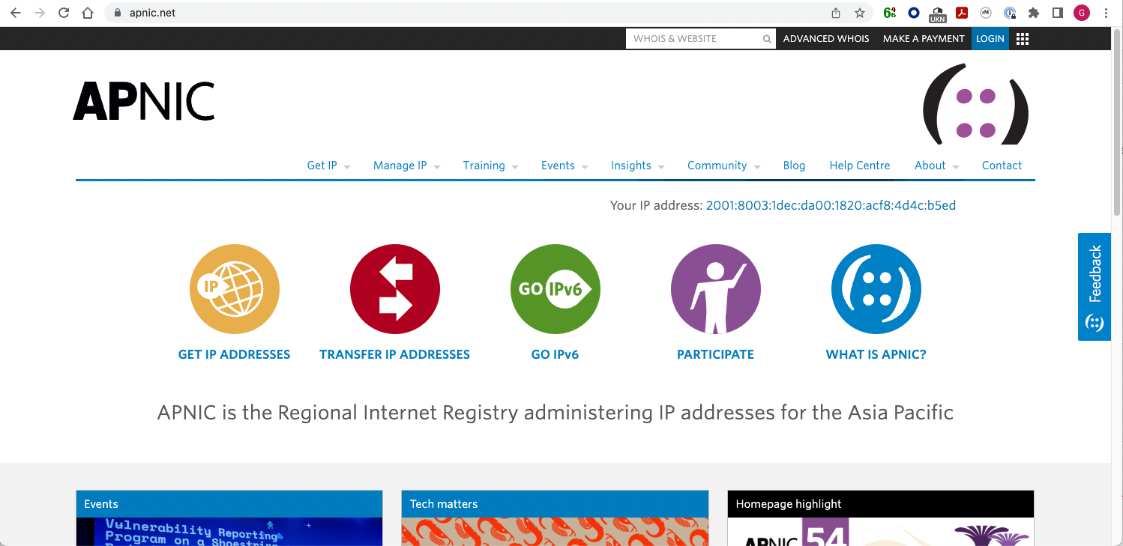

Slide 22
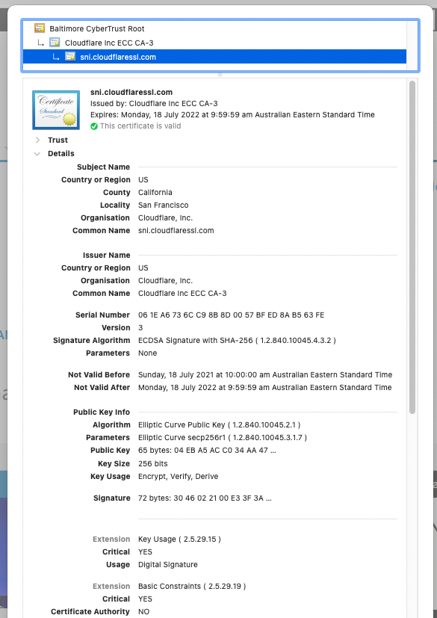

This certificate was issued to Cloudflare, not APNIC, and it is associated with the name “www.apnic.net through the use of a Subject Alternative Name in the certificate

Slide 23
And another
Let’s look at my own web site, with its certificate issued by Let’s Encrypt

Slide 24
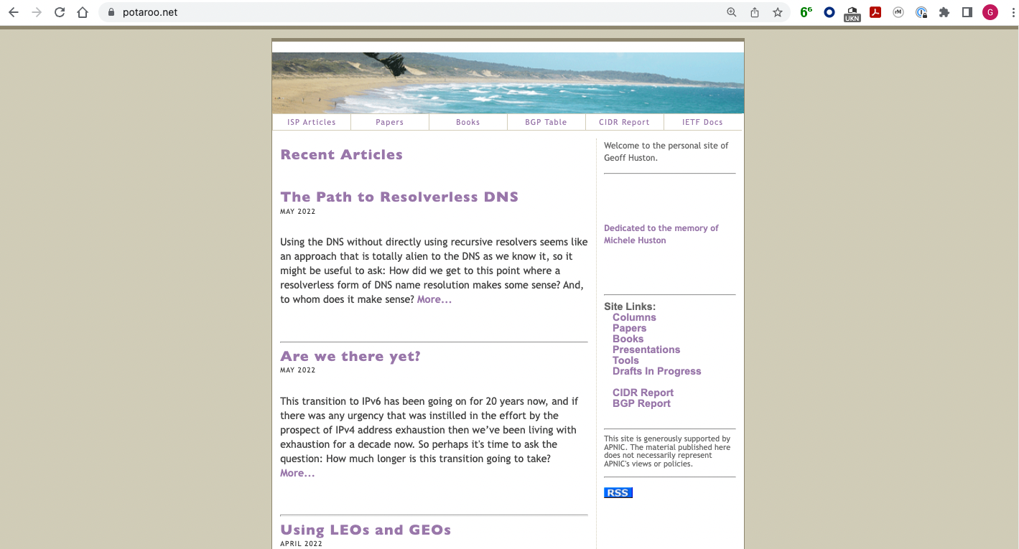
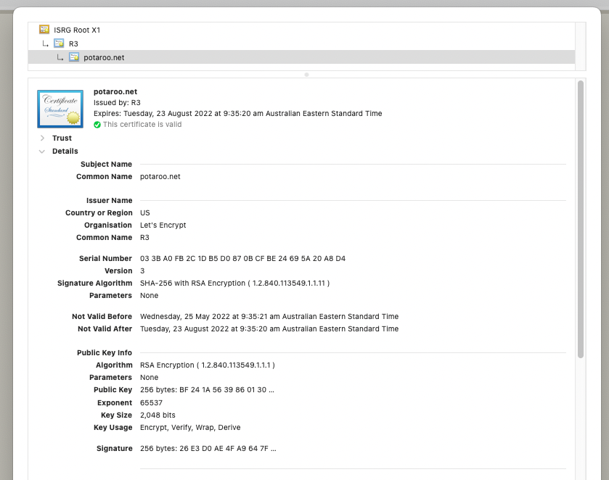
This certificate binds a public key to a domain name without any attestation to the identity of the name “holder”

Slide 25
Spot the Difference

Slide 26
Spot the Difference
This web site’s certificate was issued to an organisation called the “Commonwealth Bank of Australia” located in Sydney, Australia
This web site’s certificate was issued to “Cloudflare Inc” located in San Francisco, USA!!
This web site’s certificate says nothing about the entity that holds the public key associated with this domain

Slide 27
Spot the Difference
The certification processes used to issue the certificate were different in each of these cases.
  One confirmed the identity of the public key holder as well as their association with the domain name
  The second used a proxy agent and there is no association between the entity domain name that is certified here and the proxy agent
  The third simply associates a public key with a domain name without any form of identification of the holder of the domain name
They have very different levels of trustworthiness, yet they all display to the user in exactly the same way
  Because when we tried to differentiate these different levels of trust (such as painting the padlock icon in green) nobody understood what was going on and nobody cared anyway!

Slide 28
Spot the Difference
While there are important differences in the trustworthiness in these three certificates, they all display on the user’s screen in precisely the same way
As an attacker, if I can use the lowest threshold of proof to have a counterfeit certificate issued, then perhaps there is a viable attack vector, as the user would not notice the switch to a less strict form of subject identity validation

Slide 29
Moving on…
Ok, so the certificate system is a mess, but the subsequent secure transport session (TLS) still works, right?
Let’s look at the way TLS starts a secure session

Slide 30
Secure Connections using TLS
https://rhsecurity.wordpress.com/tag/tls/

Slide 31
Secure Connections using TLS
https://rhsecurity.wordpress.com/tag/tls/

Slide 32
Secure Connections using TLS
https://rhsecurity.wordpress.com/tag/tls/

Slide 34
Secure Connections using TLS
How does the client
recognise this certificate
as the “right” certificate?
https://rhsecurity.wordpress.com/tag/tls/

Slide 35
How did my browser know that this is a “valid” cert?

Slide 36
Domain Name Certification
The Commonwealth Bank of Australia has generated a Public/Private key pair
And they passed a certificate signing request to a company called “Entrust” in the US
Who was willing to vouch (in a certificate) that the entity is called the Commonwealth Bank of Australia and they have control of the the domain name www.commbank.com.au and they have a certain public key
So, if I can associate this public key with a connection then I have a high degree of confidence that I’ve connected to an entity that is able to demonstrate knowledge of the private key for www.commbank.com.au, as long as I am prepared to trust Entrust and the certificates that they issue
And I’m prepared to trust them because Entrust NEVER lie!

Slide 37
Domain Name Certification
The Commonwealth Bank of Australia has generated a Public/Private key pair
And they passed a certificate signing request to a company called “Entrust” in the US
Who was willing to vouch (in a certificate) that the entity is called the Commonwealth Bank of Australia and they have control of the the domain name www.commbank.com.au and they have a certain public key
So, if I can associate this public key with a connection then I have a high degree of confidence that I’ve connected to an entity that is able to demonstrate knowledge of the private key for www.commbank.com.au, as long as I am prepared to trust Entrust and the certificates that they issue
And I’m prepared to trust them because Entrust NEVER lie!
How do I know that? Why should I trust them?

Slide 38
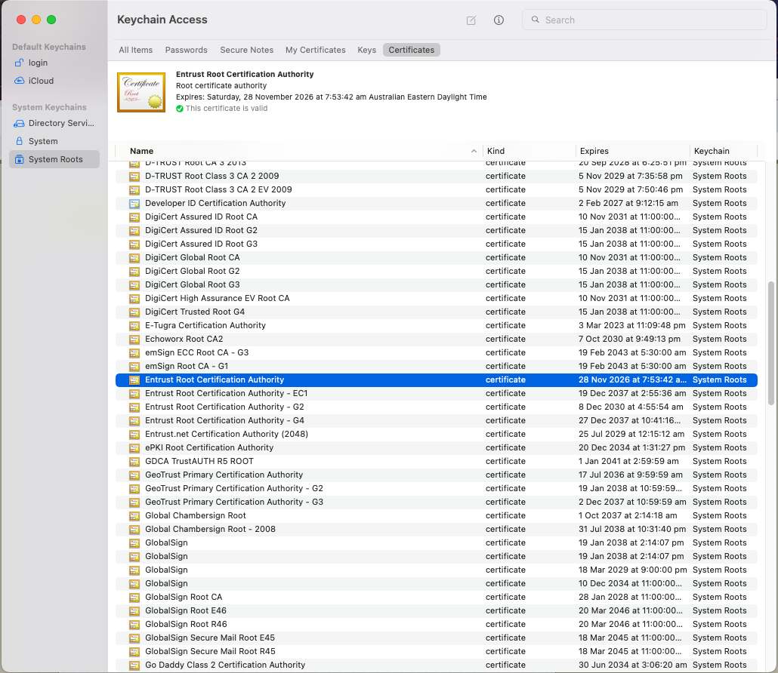
Local Trust
The cert I’m being asked to trust was issued by a certification authority that my browser already trusts – so I trust that cert!

Slide 39
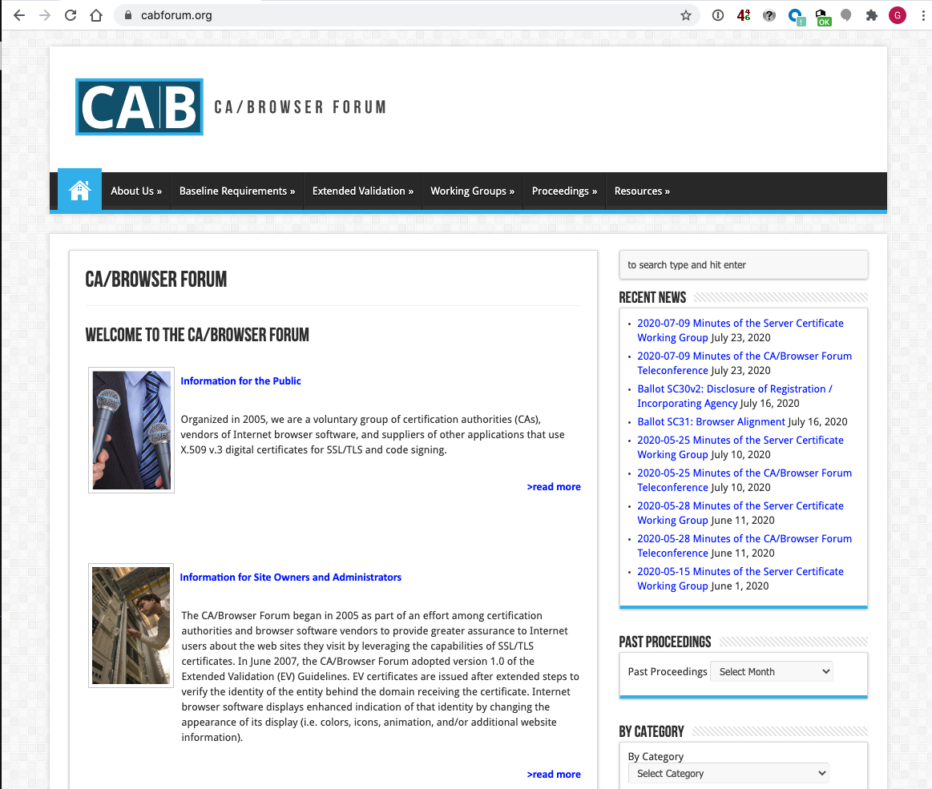
Local Trust
These Certificate Authorities are listed in my computer’s trust set because they claim to operate according to the practices defined by the CAB industry forum (of which they are a member) and they never lie!

Slide 40
Local Trust
These Certificate Authorities are listed in my computer’s trust set because they claim to operate according to the practices defined by the CAB industry forum (of which they are a member) and they never lie!
So somebody (I have never met) paid someone else (whom I have also never met) some money and then my browser trusts everything they have ever done and everything they will ever do in the future – ok?

Slide 41
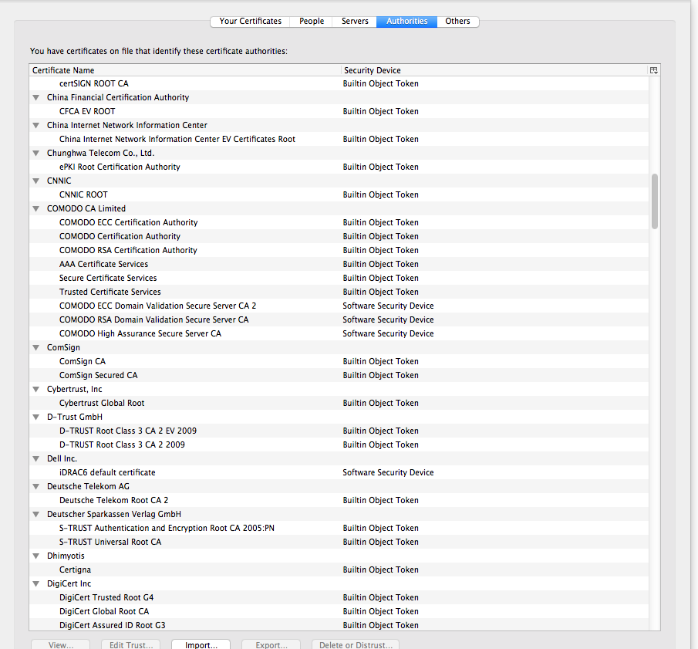
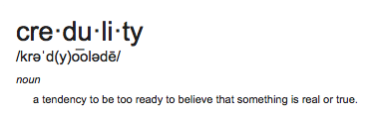
Local Trust or Local Credulity*?
Wow!
Are they all trustable?
*

Slide 42
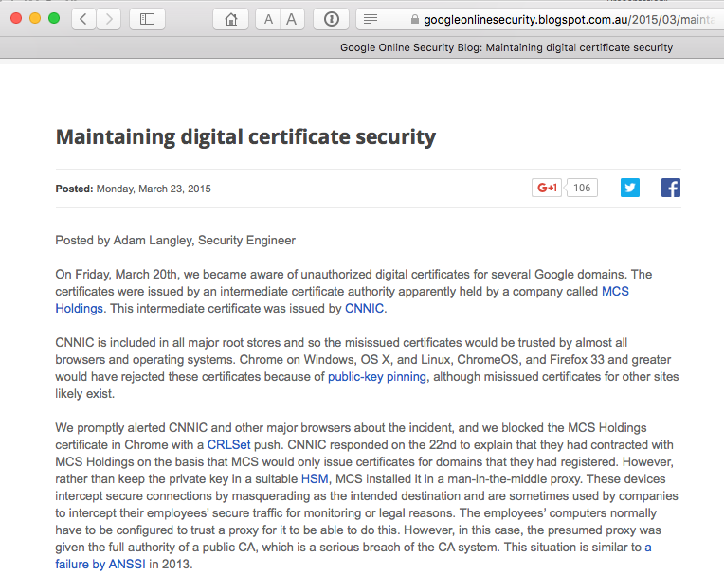
Local Credulity
Wow!
Are they all trustable?
Evidently Not!

Slide 43
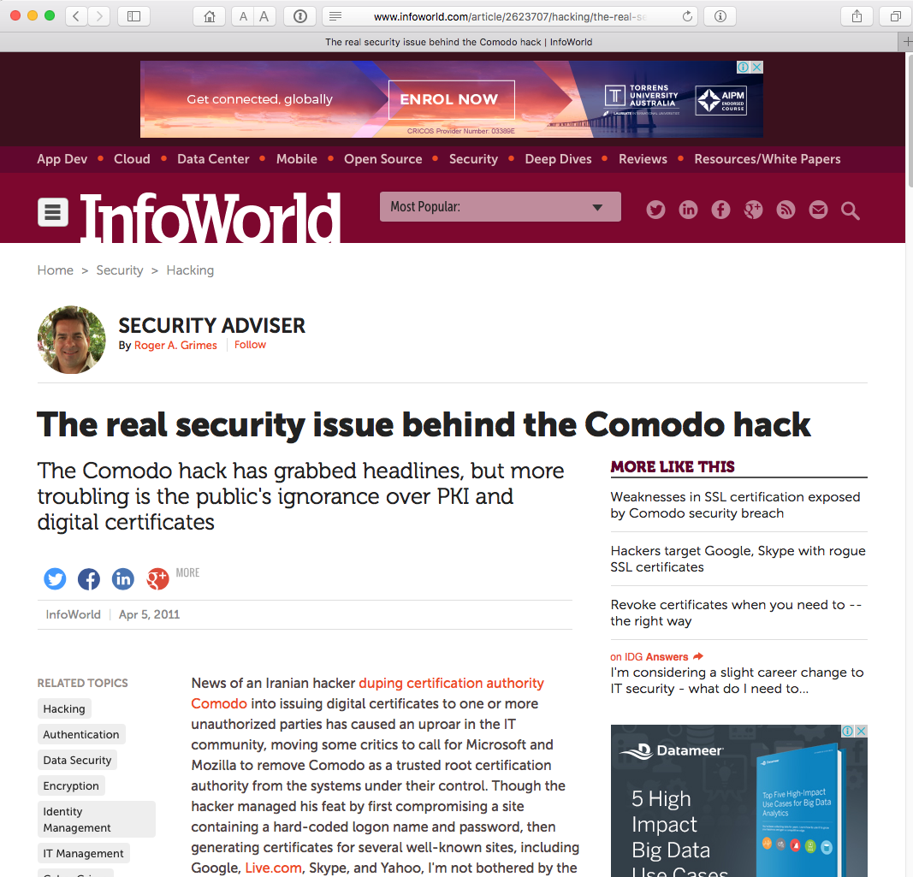
Local Credulity
Wow!
Are they all trustable?
Evidently Not!

Slide 44
Never?

Slide 45
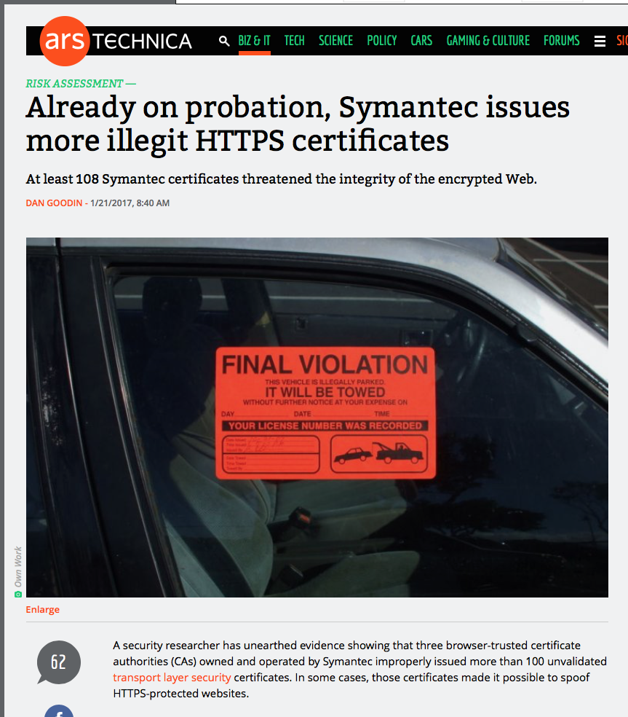
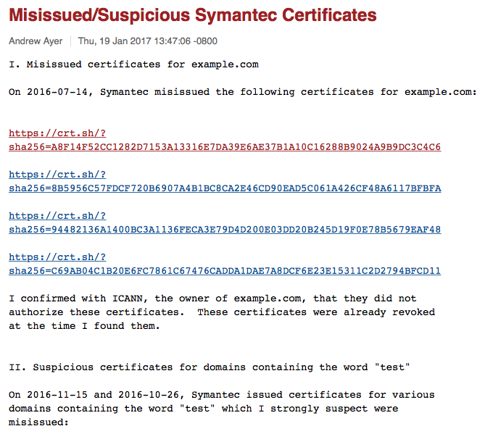
Well, hardly ever
http://arstechnica.com/security/2017/01/already-on-probation-symantec-issues-more-illegit-https-certificates/

Slide 46
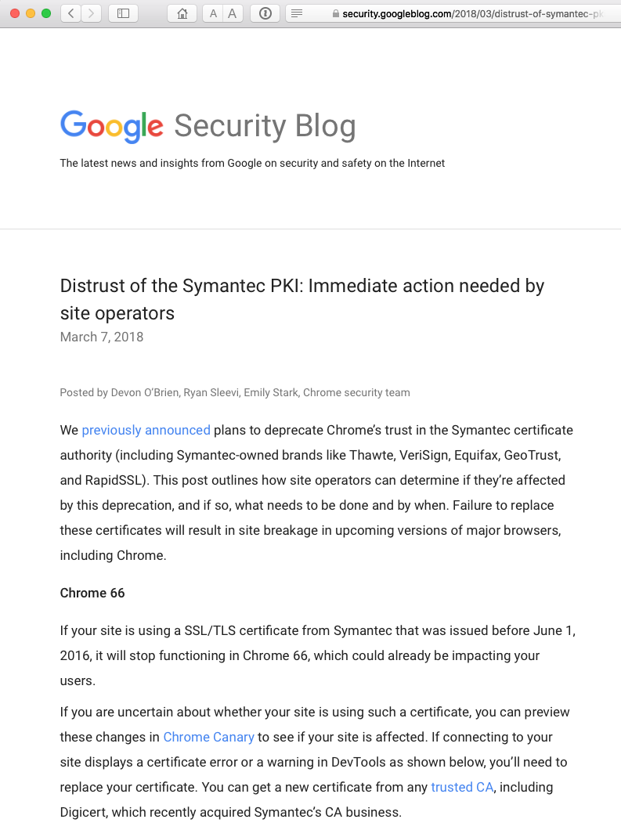
Well, hardly ever

Slide 47
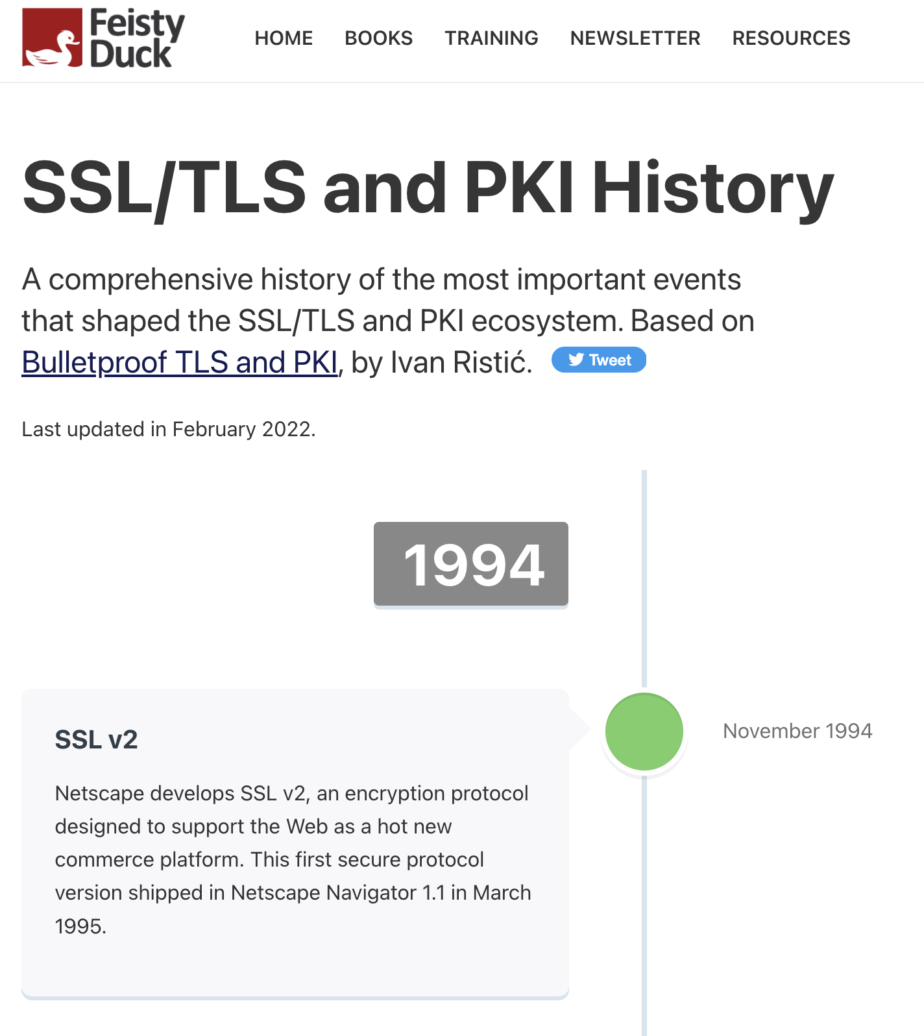
These are isolated events
No, they’re not:
https://www.feistyduck.com/ssl-tls-and-pki-history/

Slide 48
With unpleasant consequences when it all goes wrong

Slide 49
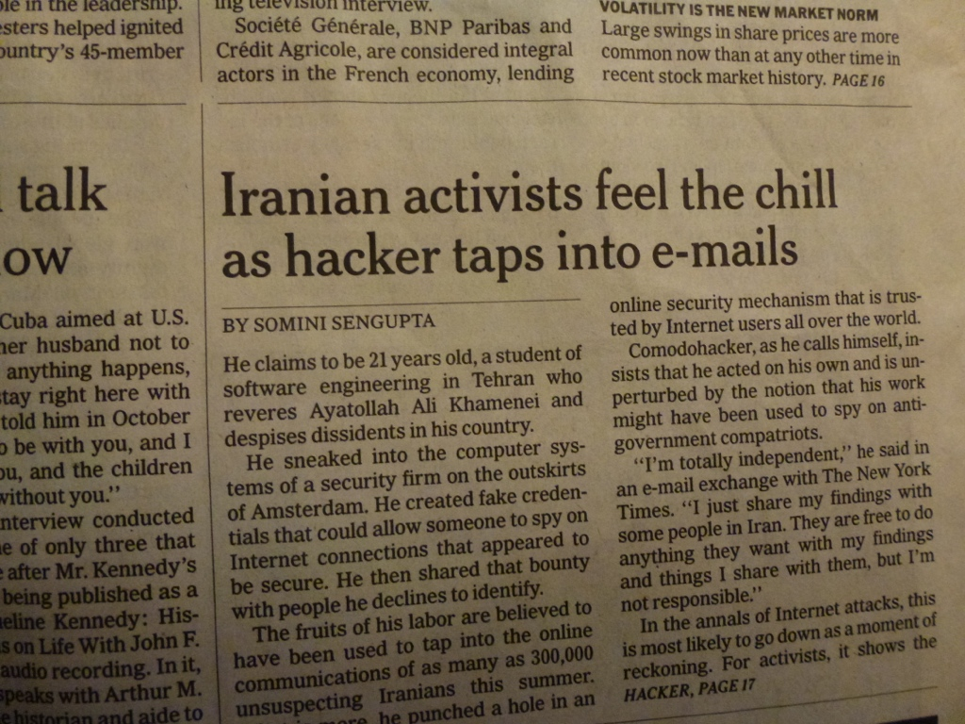
With unpleasant consequences when it all goes wrong
International Herald Tribune
Sep 13, 2011 Front Page

Slide 50
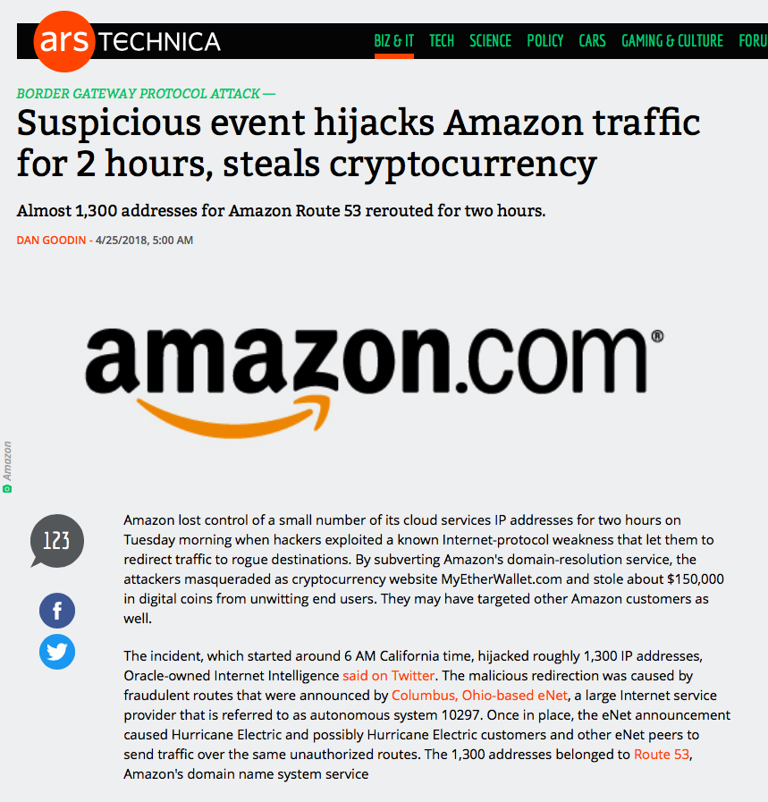

Slide 51
What’s going wrong here?

Slide 52
What’s going wrong here?
The TLS handshake cannot specify WHICH CA should be used by the client to validate the digital certificate that describes the server’s public key
The result is that your browser will allow ANY CA to be used to validate a certificate!

Slide 53
What’s going wrong here?
The TLS handshake cannot specify WHICH CA should be used by the client to validate the digital certificate that describes the server’s public key
The result is that your browser will allow ANY CA to be used to validate a certificate!
WOW! That’s awesomely bad!

Slide 54
What’s going wrong here?
The TLS handshake cannot specify WHICH CA should be used by the client to validate the digital certificate that describes the server’s public key
The result is that your browser will allow ANY CA to be used to validate a certificate!
Here’s a lock – it might be the lock on your front door for all I know.
The lock might LOOK secure, but don’t worry – literally ANY key can open it!
WOW! That’s awesomely bad!

Slide 55
What’s going wrong here?
There is no incentive for quality in the CA marketplace
Why pay more for any certificate when the entire CA structure is only as strong as the weakest CA
And your browser trusts a LOT of CAs!
  About 60 – 100 CA’s
  About 1,500 Subordinate RA’s
  Operated by 650 different organisations
See the EFF SSL observatory
http://www.eff.org/files/DefconSSLiverse.pdf

Slide 56
In a Commercial Environment
Where CA’s compete with each other for market share
And quality offers no protection
Then what ‘wins’ in the market?
Sustainable
?
Resilient
Secure
Privacy
Trusted

Slide 57
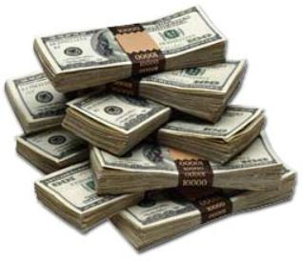
In a Commercial Environment
Where CA’s compete with each other for market share
And quality offers no protection
Then what ‘wins’ in the market?
Sustainable
Cheap!
Resilient
Secure
Privacy
Trusted

Slide 58
But it’s all OK
Really.
Because ‘bad’ certificates can be revoked
And browsers always check revocation status of certificates before they trust them

Slide 59
Always?

Slide 60
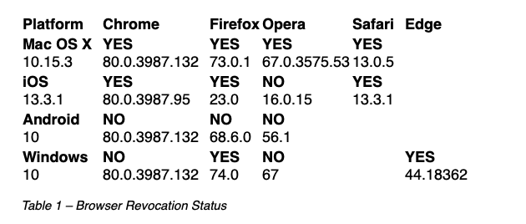
Ok – Not Always.
Some do.
Sometimes.
https://www.potaroo.net/ispcol/2020-03/revocation.html

Slide 61
So, we can’t count on revocation
If we can’t revoke certificates, then we need to reduce certificate lifetimes

Slide 62
So, we can’t count on revocation
If we can’t revoke certificates then we need to reduce certificate lifetimes
But we are not doing that!
Yes, 2026!!!

Slide 63
So, we can’t count on revocation
If we can’t revoke certificates then we need to reduce certificate lifetimes
What’s a “safe” certificate lifetime?

Slide 64
So, we can’t count on revocation
If we can’t revoke certificates then we need to reduce certificate lifetimes
What’s a “safe” certificate lifetime?
If we want 2 hours or less, then we need to think hard about how to achieve this

Slide 65
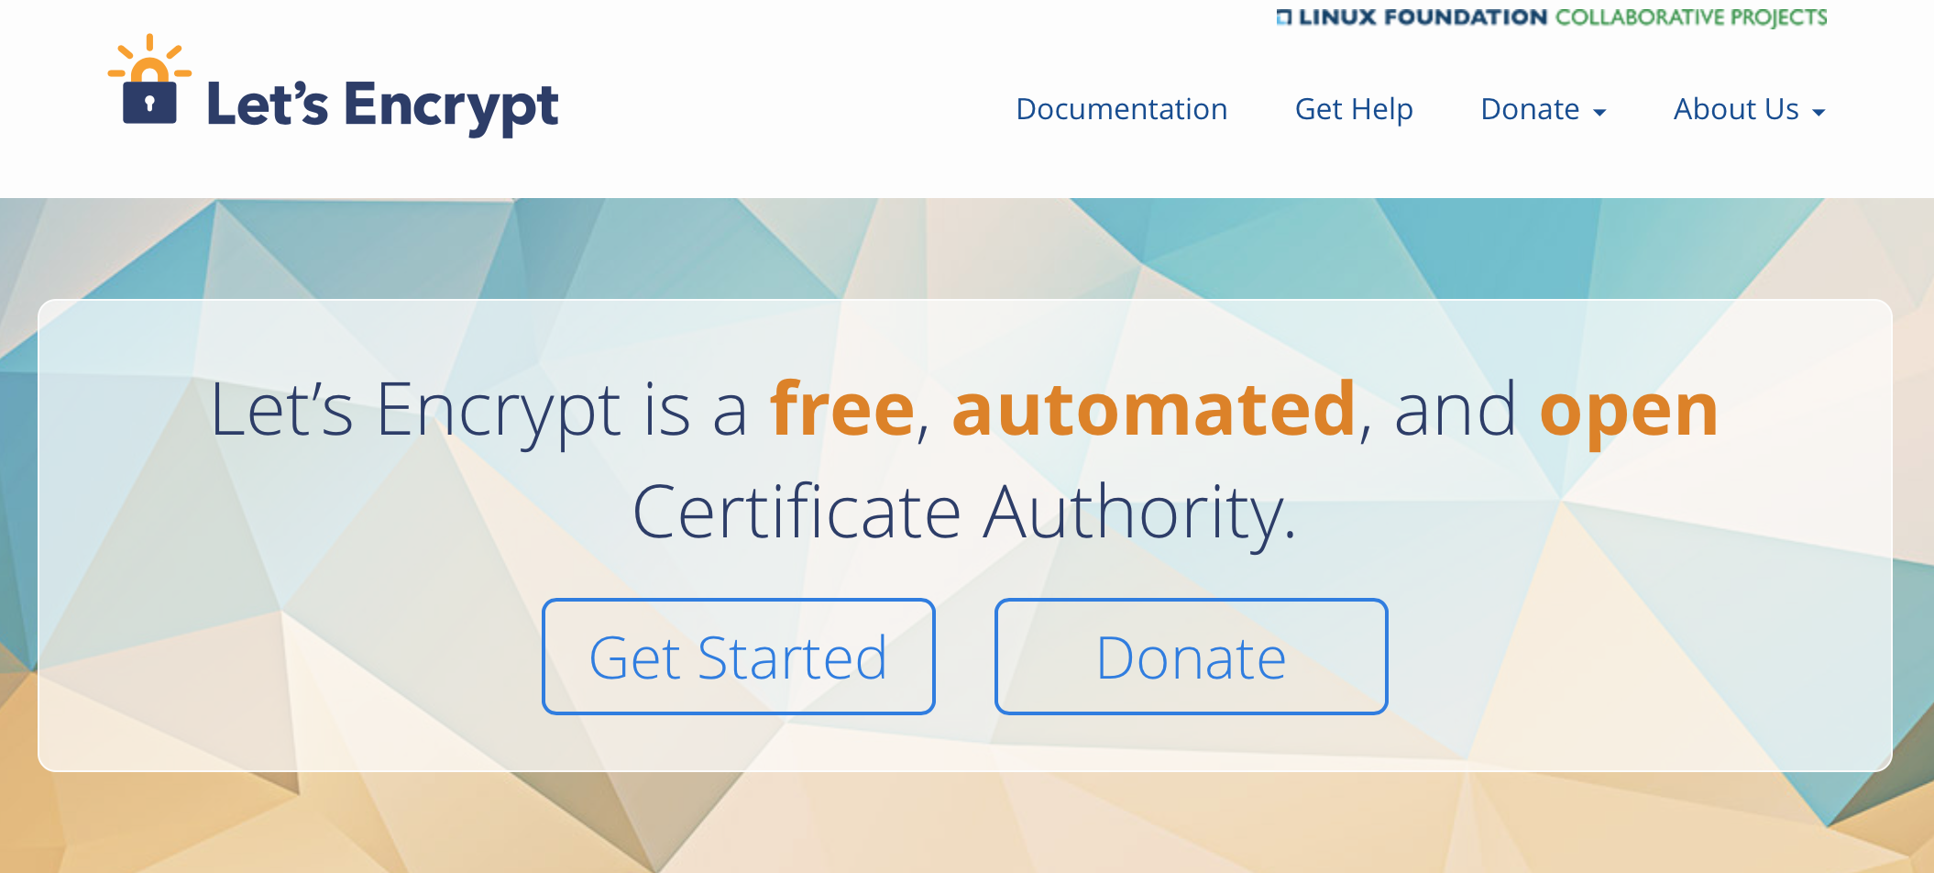
How can we make certificates better?
Option A: Take all the money out of the system!

Slide 66
How can we make certificates better?
Option A: Take all the money out of the system!
Will the automation of the Cert Issuance coupled with a totally free service make the overall environment more or less secure?
I think we already know the answer!

Slide 67
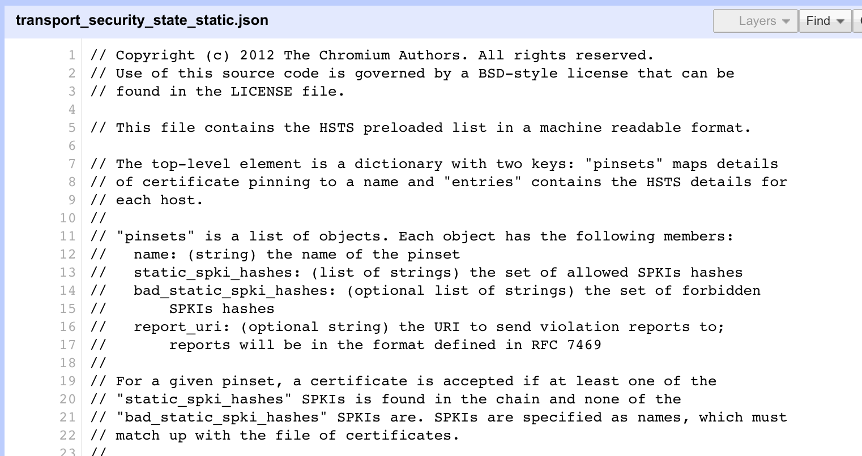
How can we make certificates better?
Option B: White Listing and Pinning with HSTS
https://code.google.com/p/chromium/codesearch#chromium/src/net/http/transport_security_state_static.json

Slide 68
How can we make certificates better?
Option B: White Listing and Pinning with HSTS
https://code.google.com/p/chromium/codesearch#chromium/src/net/http/transport_security_state_static.json
Its not a totally insane idea -- until you realise that it appears to be completely unscaleable!
Its just Google protecting itself and no one else

Slide 69
How can we make certificates better?
Its not a totally insane idea -- until you realise that it appears to be completely unscaleable!
Its just Google protecting itself and no one else
Option B: White Listing and Pinning with HSTS
https://code.google.com/p/chromium/codesearch#chromium/src/net/http/transport_security_state_static.json

Slide 70
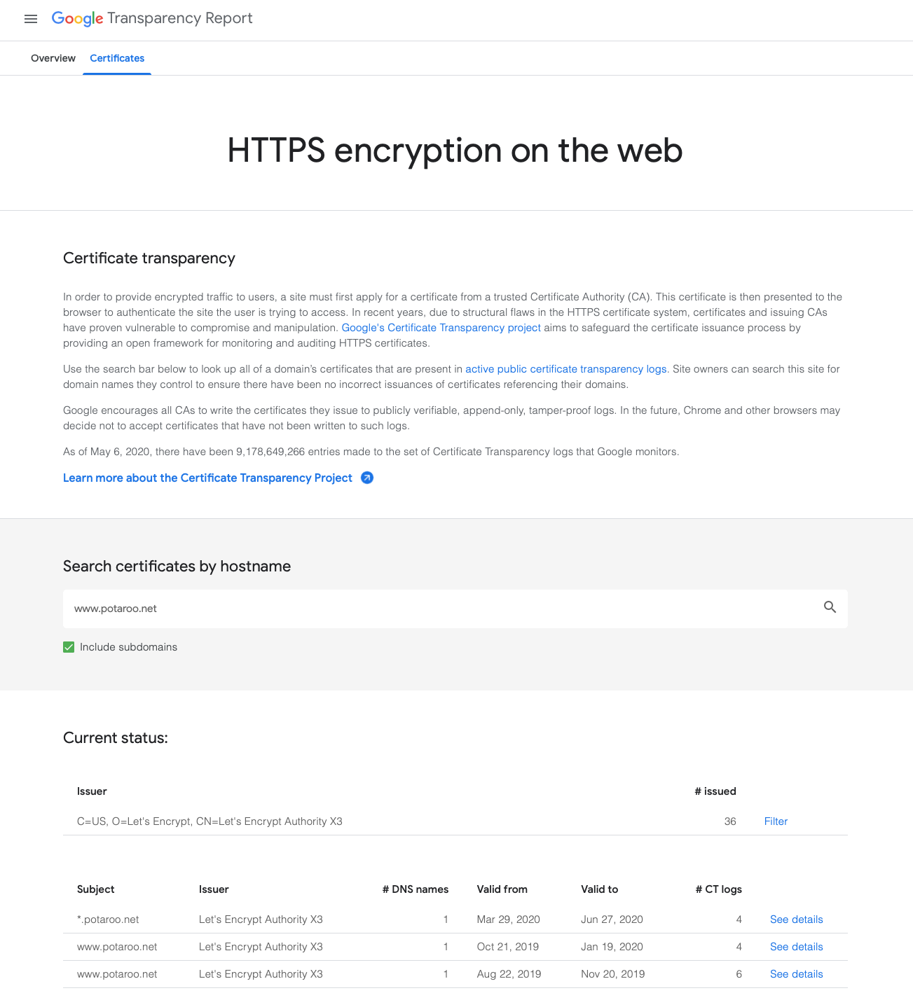
How can we make certificates better?
Option C: Certificate Transparency

Slide 71
How can we make certificates better?
Option C: Certificate Transparency
This is true
This is a fail

Slide 72
How can we maske certificates better?
Option C: Certificate Transparency
Its just so broken
These transparency logs are a case of same week service in a millisecond world -- Assuming anyone looks in the first place!
Cert Transparency is probably worse than a placebo!

Slide 73
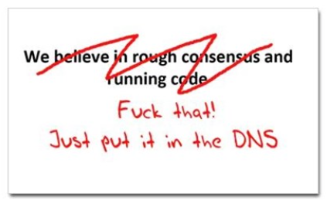
How can we make certificates better?
Option D: Use the DNS!
www.cafepress.com/nxdomain

Slide 74
Seriously? The DNS?
Where better to find out the public key associated with a DNS-named service than to look it up in the DNS?
  Why not query the DNS for the HSTS record?
  Why not query the DNS for the issuer CA?
  Why not query the DNS for the hash of the domain name cert?
  Why not query the DNS for the hash of the domain name public key?

Slide 75
Seriously? The DNS?
Where better to find out the public key associated with a DNS-named service than to look it up in the DNS?
  Why not query the DNS for the HSTS record?
  Why not query the DNS for the issuer CA?
  Why not query the DNS for the hash of the domain name cert?
  Why not query the DNS for the hash of the domain name public key?
Who needs CA’s anyway?

Slide 76
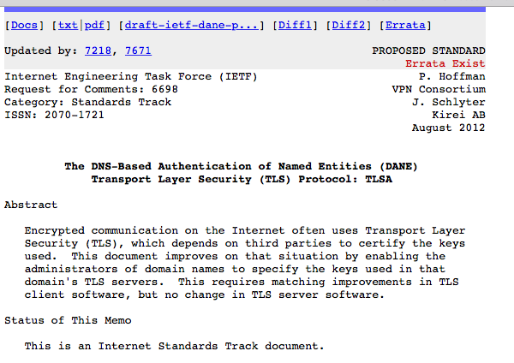
DANE
Using the DNS to associated domain name public key certificates with domain name
RFC6698 -- You should read this!

Slide 77
TLS with DANE
Client receives server cert in Server Hello
  Client lookups the DNS for the TLSA Resource Record of the domain name
  Client validates the presented certificate against the TLSA RR
Client performs Client Key exchange

Slide 78
TLS Connections
DNS Name
DNS TLSA query
Public Key
Cert
https://rhsecurity.wordpress.com/tag/tls/

Slide 79
Just one problem…
The DNS is full of liars and lies!
And this can compromise the integrity of public key information embedded in the DNS
Unless we fix the DNS we are no better off than before with these TLSA records!

Slide 80
Just one response…
We need to allow users to validate DNS responses for themselves
And for this we need a Secure DNS framework
Which we have – and it’s called DNSSEC!

Slide 81
DANE + DNSSEC
Query the DNS for the TLSA record of the domain name and ask for the DNSSEC signature to be included in the response
Validate the signature to ensure that you have an unbroken signature chain to the root trust point
At this point you can accept the TLSA record as the authentic record, and set up a TLS session based on this data

Slide 82
DANE + DNSSEC
Query the DNS for the TLSA record of the domain name and ask for the DNSSEC signature to be included in the response
Validate the signature to ensure that you have an unbroken signature chain to the root trust point
At this point you can accept the TLSA record as the authentic record, and set up a TLS session based on this data
Yes, but No!

Slide 83
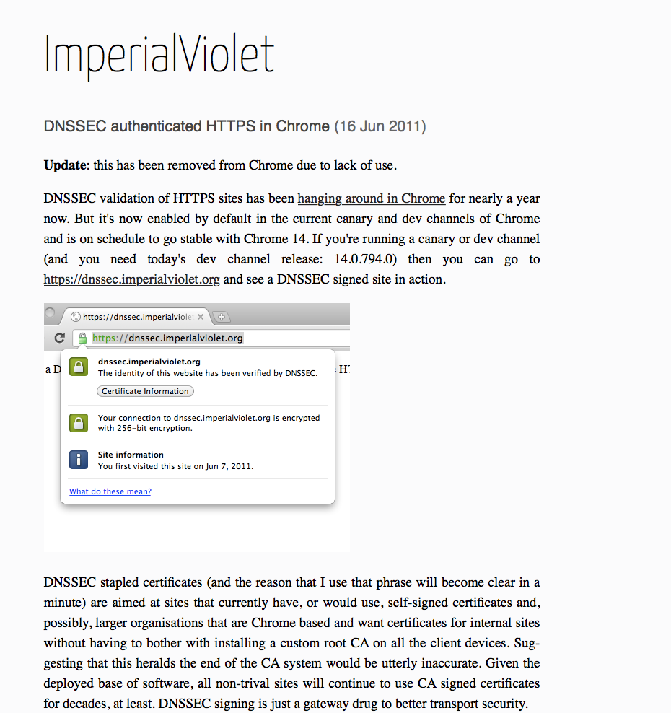
DANE + DNSSEC
DANE validation can be SO SLOW!

Slide 84
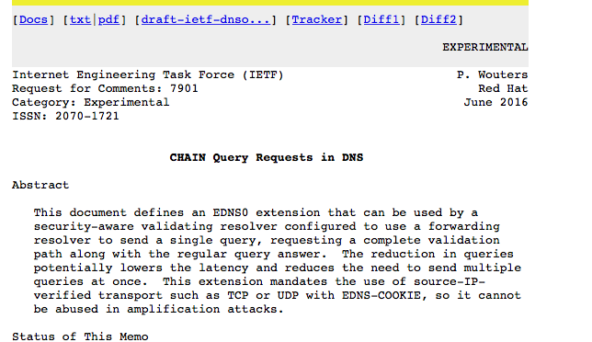
Or…
Faster validation?

Slide 85
Or … Look! No DNS!
Server packages server cert, TLSA record and the DNSSEC credential chain in a single bundle
Client receives bundle in Server Hello
  Client performs validation of TLSA Resource Record using the supplied DNSEC signatures plus the local DNS Root Trust Anchor without performing any DNS queries
  Client validates the presented certificate against the TLSA RR
Client performs Client Key exchange

Slide 86
Doing a better job
We could do a far better job at Internet Security by moving on from X.509 public key certificates:
Publishing DNSSEC-signed zones
Publishing DANE TLSA records
Using DNSSEC-validating resolution
Using TLSA records to guide TLS Key Exchange
Stapling the TLSA + sig bundle into TLS

Slide 87
Doing a better job
We could do a far better job at Internet Security by moving on from X.509 public key certificates:
Publishing DNSSEC-signed zones
Publishing DANE TLSA records
Using DNSSEC-validating resolution
Using TLSA records to guide TLS Key Exchange
Stapling the TLSA + sig bundle into TLS
But nothing has happened for more than a decade!
Why not?

Slide 88
2. Looking Forward

Slide 89
Why is this so hard?

Slide 90
Why is this so hard?
We have different goals
  Some people want to provide strong hierarchical controls on the certificates and keys because it entrenches their role in providing services
  Some want to do it because it gives them a point of control to intrude into the conversations of their citizens
  Others want to exploit weaknesses in the system to leverage a competitive advantage
  Some people think users prefer faster applications, even if they have security weaknesses
  Others think users are willing to pay a time penalty for better authentication controls

Slide 91

Why is this so hard?
Because there are so many moving parts?
  In a system that is constructed upon the efforts of multiple systems and multiple providers we are relying on someone in charge to orchestrate the components to as working whole
Saturn V Launch Vehicle
Three stage rocket, each built by a different contractor
Each of whom used multiple subcontractors
3 million components
Each supplied by the lowest bidder!

Slide 92
Will it get harder?
Quantum Risk
Public/Private key cryptography does not create “impossible” problems. It uses “hard” problems.
But “hard depends on the speed of available CPUs and the way that CPUs calculate
Quantum computing can potentially solve such “hard” problems, assuming that we get to the point of being able to operate quantum computers with large numbers of qbits.
So far that challenge has proved elusive, but a lot of effort is being invested into quantum computing these days
When it happens, we will need to turn to more complex crypto algorithms that have larger keys and require more compute power to use

Slide 93
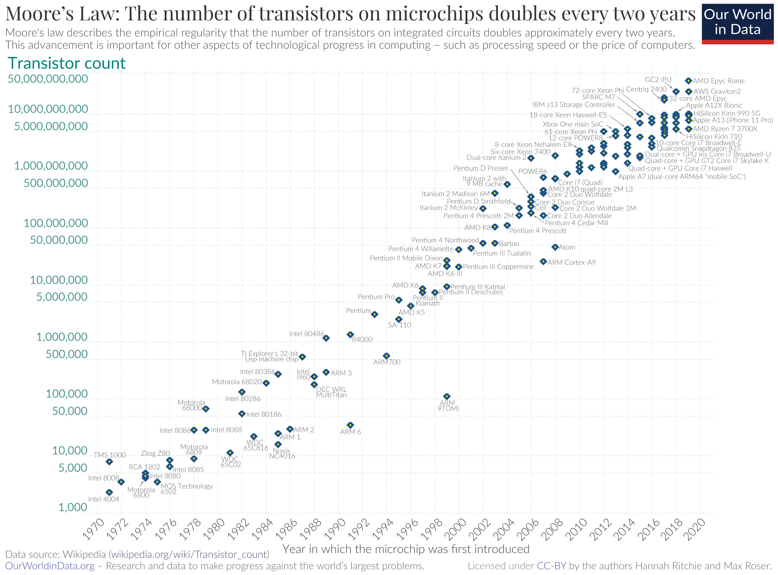
Will it get more expensive?
So far Moore’s Law has absorbed the incremental cost of crypto
As we get to 3nm tracks on chips further reductions in size and unit cost are proving to be a major challenge
Which implies that robust crypto may become more expensive to use
Who is going to pay the incremental cost of highly robust crypto?
Silicon Chip transistor counts

Slide 94
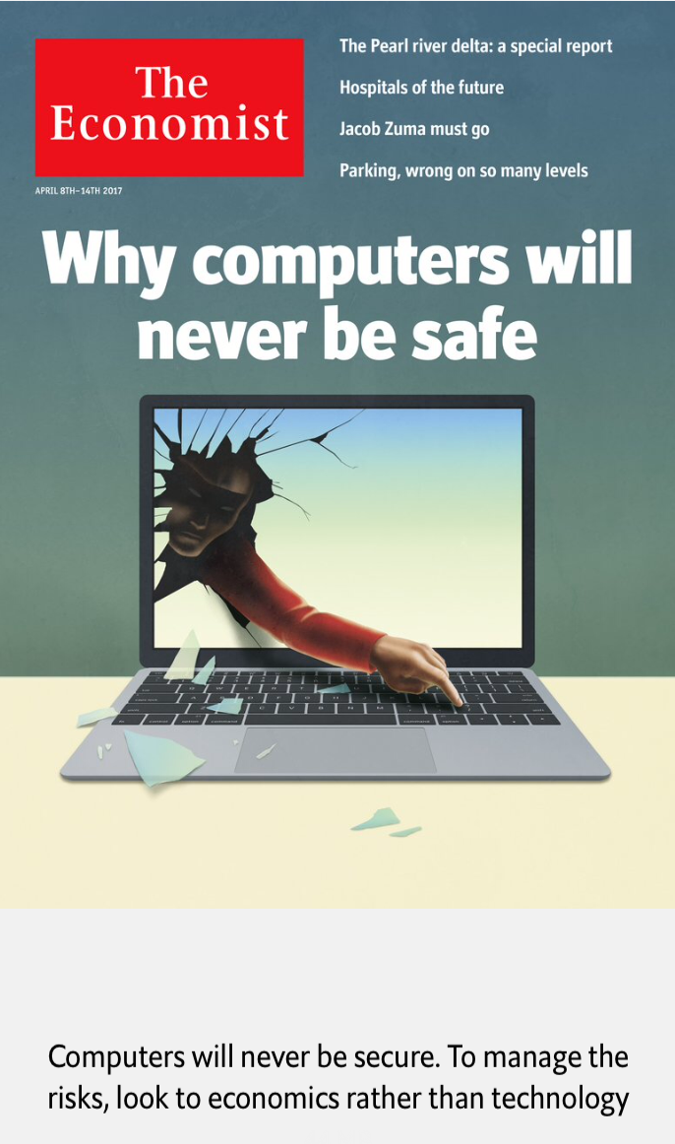
It’s a tough problem…
A rather bleak prognosis from the
Economist – don’t look for technology to improve this rather disturbing situation!
They suggest looking at economics and markets to try and address this problem
The problem with this suggestion is that there is no natural market that provides incentive for highly robust and secure technologies. The major market incentives are based on driving down unit costs of service delivery, and security is an obvious point of avoidable cost

Slide 95
The Economics of Security
Effective security for services and infrastructure is a market failure in the IT industry
Consumers are unwilling to pay a major price premium for a highly robust service
Service providers do not have any market-based incentive to add robust security to their products and offerings
The reason why the public sector is undertaking investment in cyber defence measures is that the private sector is not naturally motivated to do so!

Slide 96
The Economics of Security
Domain Name certificates have only taken off when the cost of obtaining them has dropped to zero, and the demonstration of proof of control is cursory
And in a demonstration that Gresham’s Law applies equally well in security, the low-quality cheap certificate product has driven out other forms of extended validation certification

Slide 97
The Internet of Things
Only makes it so much worse:….
"The market can't fix this because neither the buyer nor the seller cares.
The owners of the low-cost devices used in distributed denial-of-service attacks don't care. Their devices were cheap to buy, they still work, and they don't know any of the victims of the attacks.
The sellers of those devices don't care: They're now selling newer and better models, and the original buyers only cared about price and features.
There is no market solution, because the insecurity is what economists call an externality: It's an effect of the purchasing decision that affects other people. Think of it as a kind of invisible pollution."
https://www.schneier.com/blog/archives/2017/02/security_and_th.html

Slide 98
Why is this so hard?
Because we are relying on the market to provide coherence and consistency of orchestration across providers?
  And perhaps that’s the key point here
  Loosely coupled systems will always present windows of vulnerability
    Routing integrity
    Name registration
    Name certification
    Service control
  Effective defence involves not only component defence but also in defending the points of interaction between components
  And we find this very hard to achieve when the market itself is the orchestration agent

Slide 99
Is this another of those massive challenges of our time?
We just don’t have the tools to figure out how to stop this environment being fatally overrun by these devices:
  We can’t improve their quality
  We can’t keep building ever larger DOS barriers
  We can’t regulate behaviours of the equipment, their makers or distributors

Slide 100
What a dysfunctional mess we’ve created!

Slide 101
3. Vague Glimmers of Hope

Slide 102
This is not a new problem
We had a similar problem in the aviation industry
  Safety was a real issue for the industry
  The response was to shift the emphasis in investigation of incidents from blame attribution to primary cause identification
Do we need open disclosure requirements for IT goods and services?

Slide 103
This is not a new problem
Industry-based safety standards have been used in other industries
Do consumer products and services need to comply to a set of base standards relating to operational robustness?
In today’s world of digital goods and services how would such standards be applied?

Slide 104
Users and Trust
Users just want to be able to trust that the websites and services that they connect to and share their credentials, passwords and content with are truly the ones they expected to be using without first studying for a PhD in Network Operational Security
Somehow, we’re missing that simple objective and we’ve interposed complexity and adornment that have taken on a life of their own and are in fact eroding trust
And that’s bad!
If we can’t trust our communications infrastructure, then we don’t have a useful communications infrastructure.

Slide 105
Questions?

